Slide 1
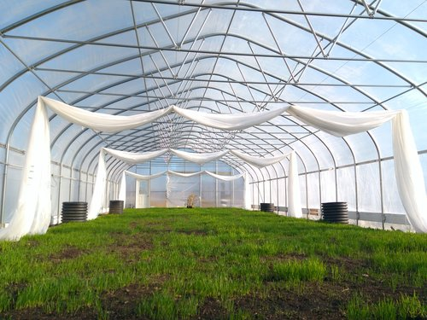
Climate Battery Team 18
Christopher Arney, Nicholas Horley, Mark Legutko, Brandon Noggle
Sponsored by Threefold Farm

Slide 2
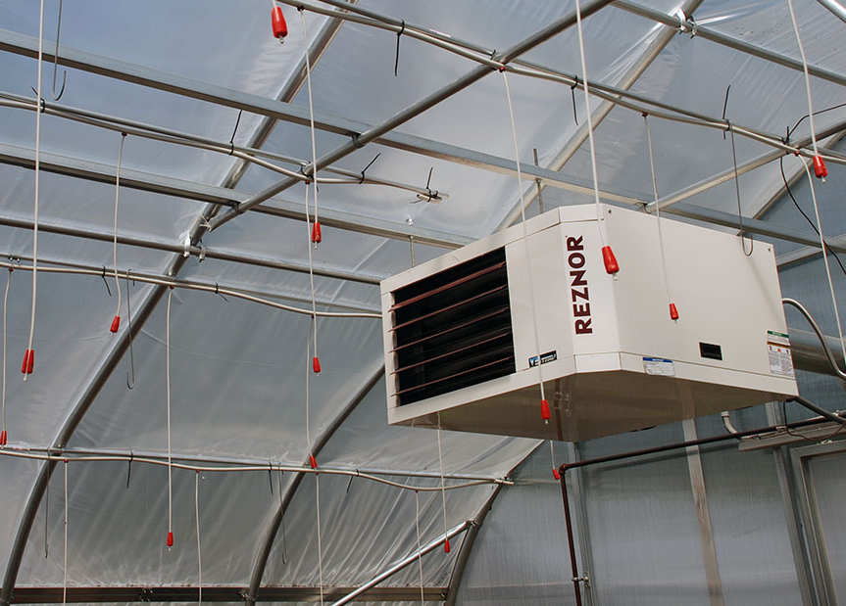
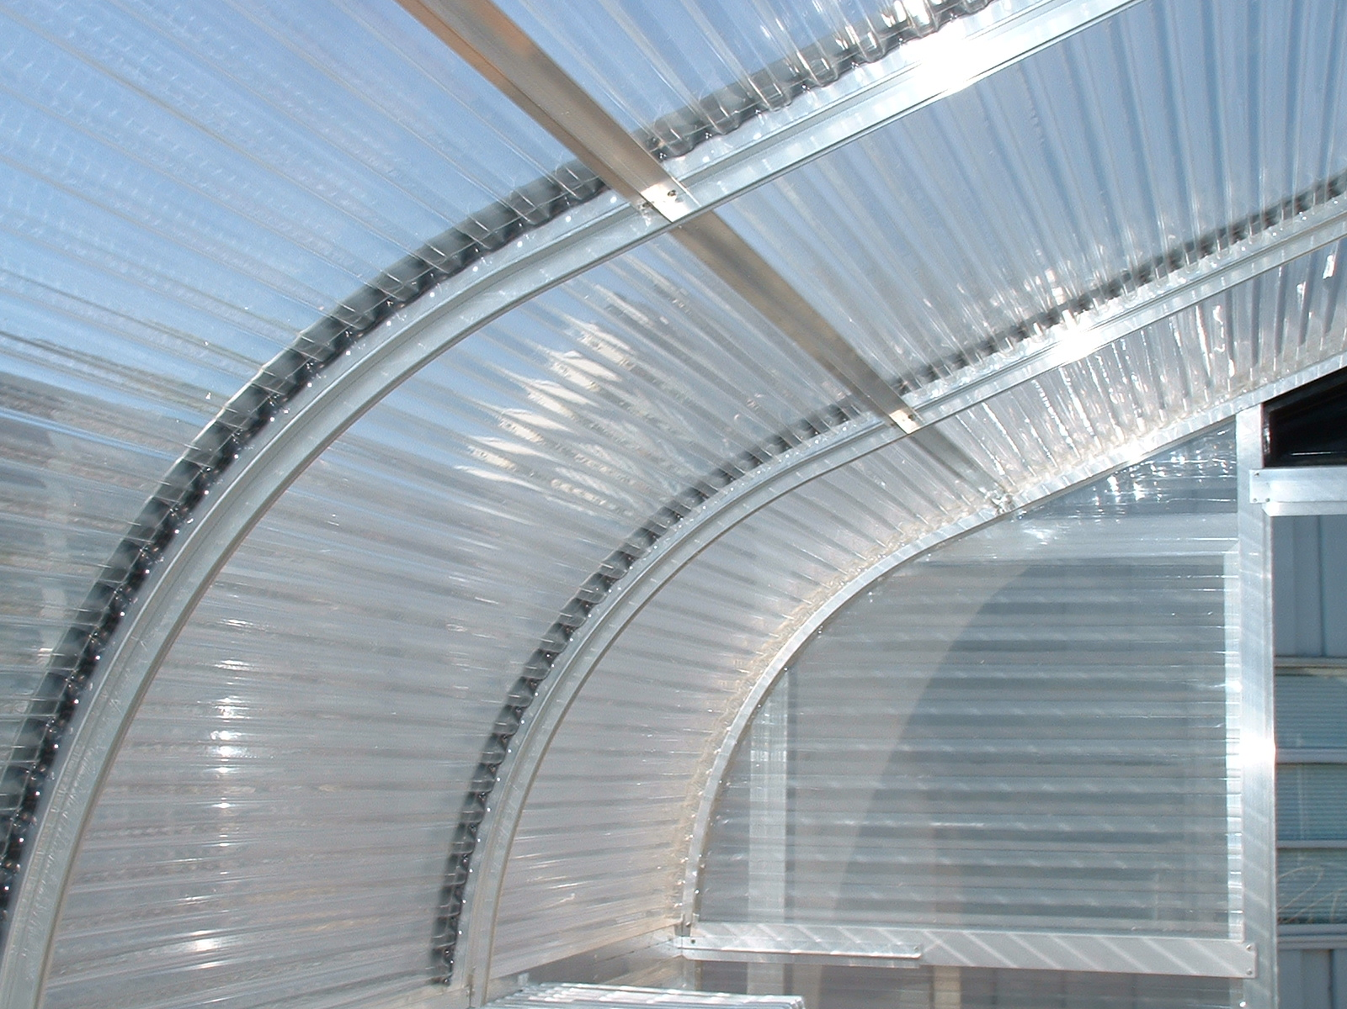
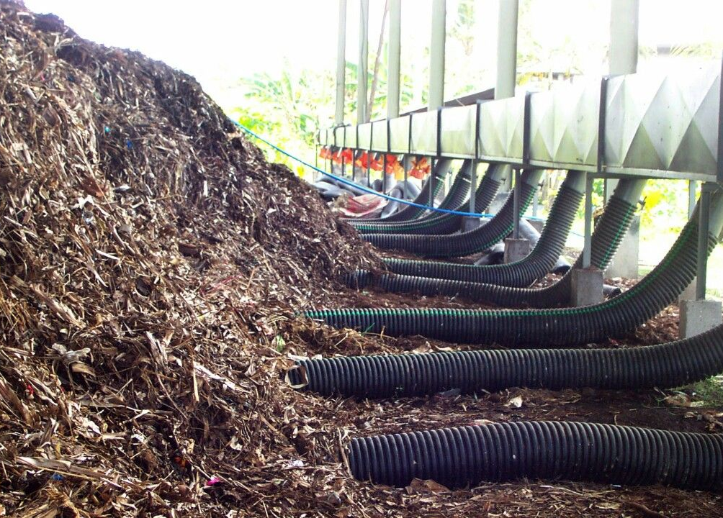
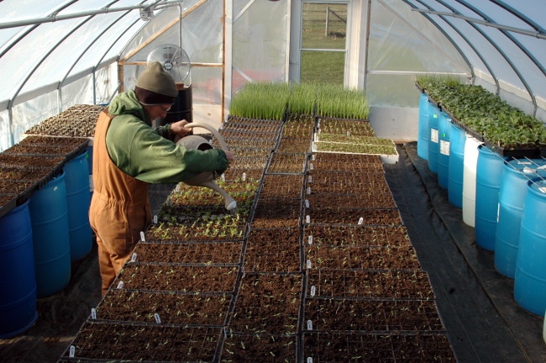
Greenhouse Heating Solutions
Heater
Thermal Mass
Compost
Insulation

Slide 3
Climate Battery
Fan and Inlet
Outlet
Manifolds
Tubes

Slide 4
Gray House
30' x 96' greenhouse
26' x 88' climate battery
3 systems
5,000 CFM fans
Tubes between 2' and 4' below grade

Slide 5
Blue House
34' x 96' greenhouse
21' x 84' climate battery
12 systems
425 CFM fans
6 systems 3' below grade
6 systems 6' below grade

Slide 6
Temperature Study
Collected data from 44 sensors
Ground temperatures
Air temperatures and humidity
Riser temperature

Slide 7
Gray House Sensor Layout

Slide 8
Blue House Sensor Layout

Slide 9
Average Air Temperature Throughout Study

Slide 10
Gray House During Coldest Week

Slide 11
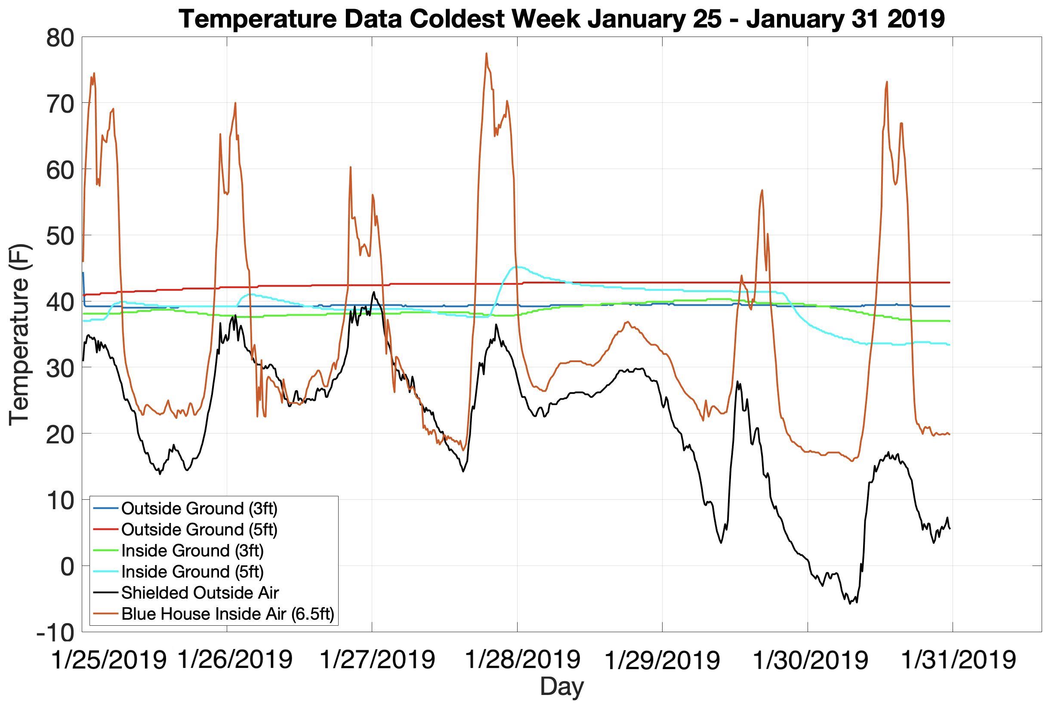
Blue House During Coldest Week

Slide 12
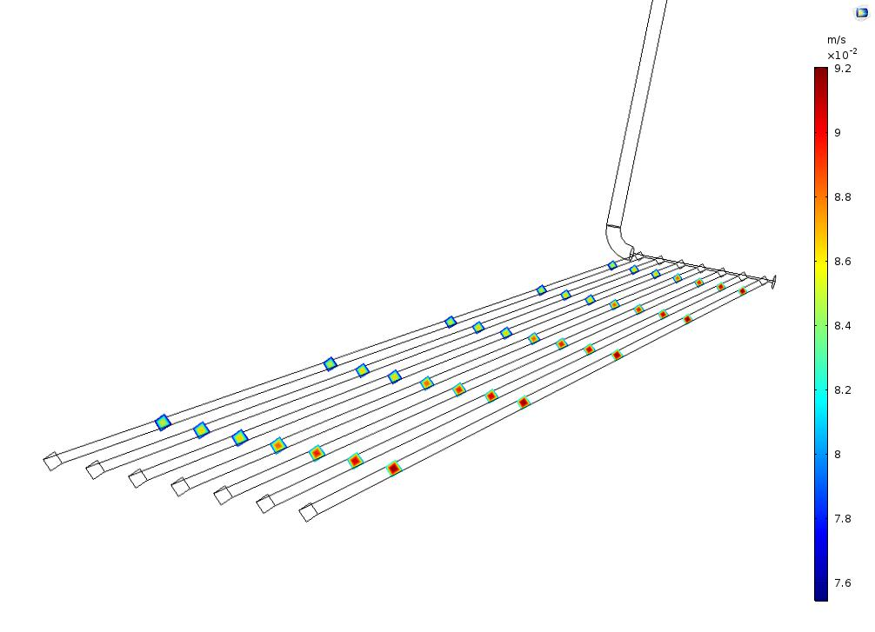
Airflow
Turbulent flow increases the rate of heat transfer
Uneven distribution
COMSOL model of airflow through a tube

Slide 13
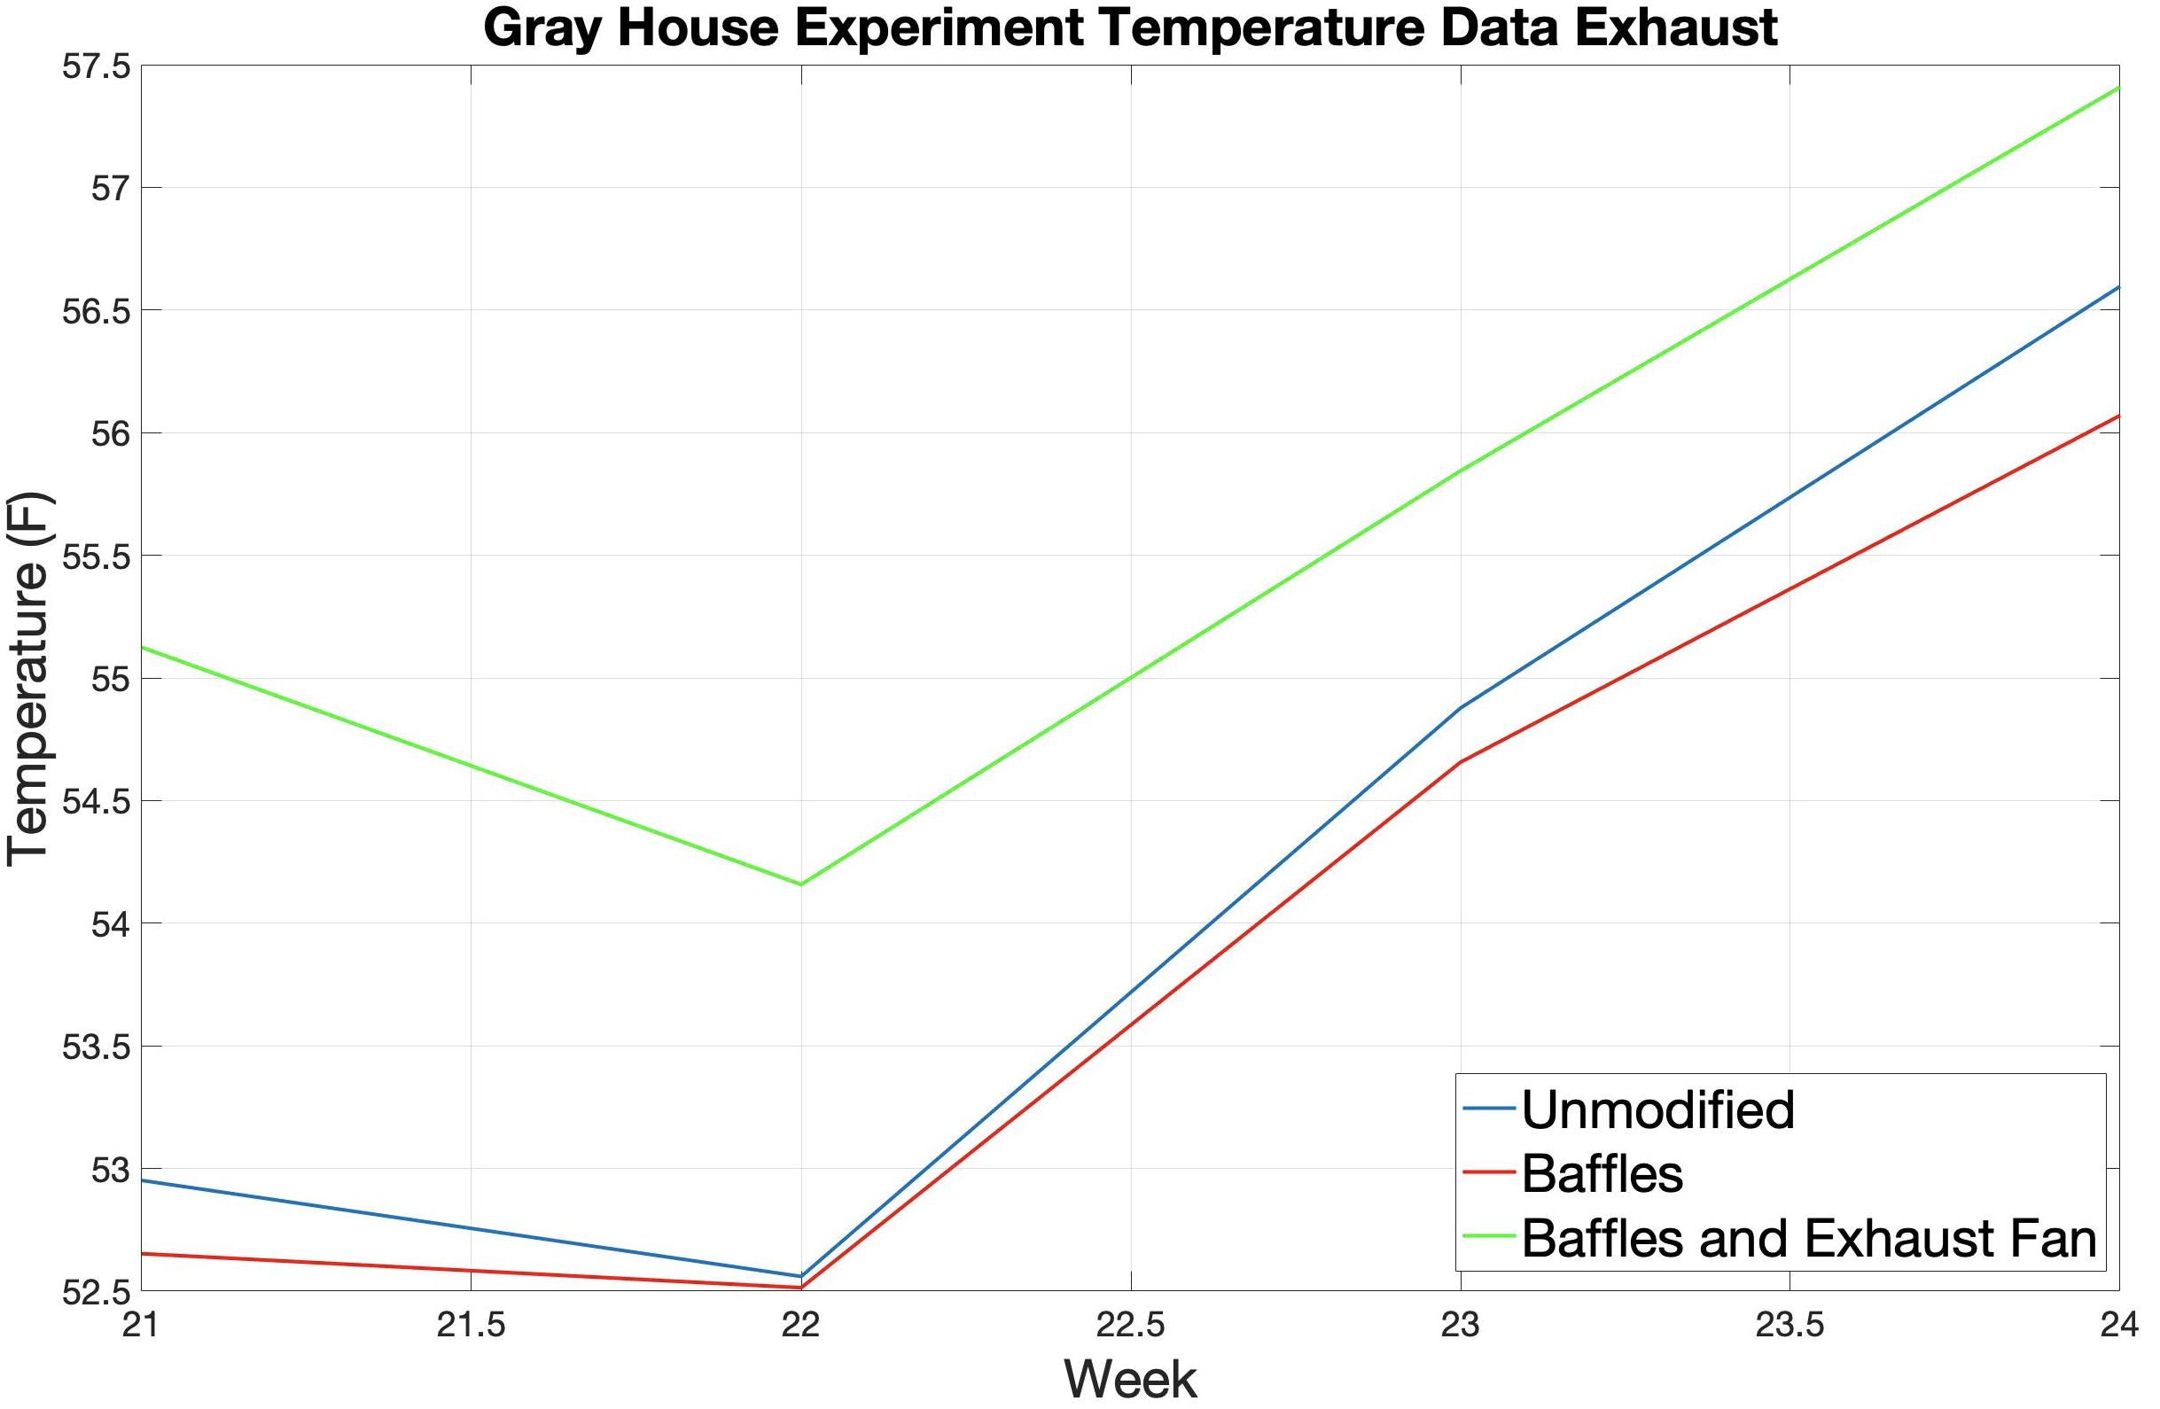
Gray House Baffles and Boosters

Slide 14
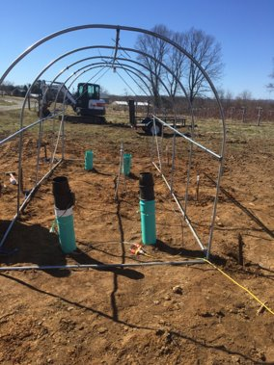
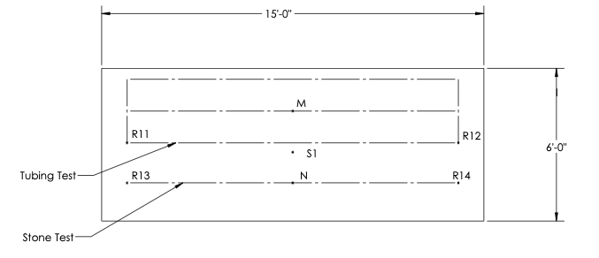
Mini Greenhouse Test

Slide 15
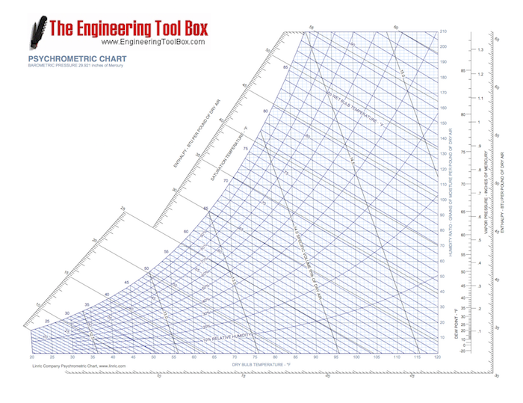
Psychrometric Calculations

Slide 16
System Capacities
Greenhouse | Heat Transfer Rate Heating (BTU/hr) | Heat Transfer Rate Cooling (BTU/hr)
Gray | 103,127.87 | 153,230.86
Blue | 242,337.42 | 992,556.12
Test Set | Heat Transfer Rate Per System Heating (BTU/hr) | Heat Transfer Rate Per System Cooling (BTU/hr)
Unmodified System (R1,R2) | 30,462.08 | 49,293.60
Baffles in 23 Tubes (R7,R8) | 34,185.97 | 47,723.98
Baffles in 23 Tubes, Booster Fan (R9,R10) | 38,479.82 | 56,213.28

Slide 17
Efficiencies and Coefficient of Performance
Greenhouse | Heat Transfer Rate Heating (BTU/hr) | Heat Transfer Rate Cooling (BTU/hr) | Sample Calculation
Gray | 82,502.30 | 122,584.69 | AHTR = HTR * 0.8
Blue | 135,708.96 | 555,831.43 | AHTR = HTR * 0.56
Greenhouse | Total Fan Power Draw (kW) | Coefficient of Performance | Sample Calculation
Gray | 1.2 | 32.69 | COP = HTR / (P * 3412)
Blue | 0.924 | 6.81 | COP = HTR / (P * 3412)

Slide 18
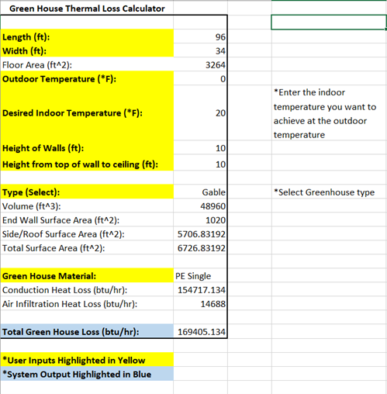
Sizing Calculator

Slide 19
Future System Recommendations
Soil is better than stone
12” center to center tube spacing
Baffles promote airflow
Booster Fans increase heat transfer
Primary fans should have a high CFM
4’-6’ buffer between CB and GH walls
High humidity
High risers
Notes:
To conclude the study some recommendations were requested for improvement of future climate batteries. After extensively studying the operation of both climate batteries it is recommended that future climate batteries use a system similar to the gray house with some adjustments to improve function. Placing tubes directly in the soil instead of in stone is much more efficient when using the climate battery to heat because the tubing system can access the heat. Stone is a very good insulator, and therefore is not recommended around the tubes. It is best to space tubes 12 inches center to center to gain maximum heat transfer into the soil during charging cycles. Placing tubes too close together causes the soil to become saturated with heat quickly which will cause it to no longer store any more heat. Adding baffles, or staggering tubes in the manifolds to promote even airflow throughout each tube is recommended to increase the even spread of heat throughout the climate battery. Primary fans in the risers should have a high CFM rating. In the gray house climate battery at Threefold Farm, the primary fans were rated to 5,000 CFM. These fans worked very well for pushing air through the climate battery system. Adding booster fans to the exhaust risers of each climate battery system will also increase heat transfer by moving more air through the system and increasing the turbulence of the air in the system to promote a higher rate of heat transfer. Four to six feet of soil should be left between the outside of the climate battery and the outside of the greenhouse to prevent unnecessary heat losses from the climate battery to the ground outside the greenhouse. Maintaining a high humidity rate in the greenhouse allows air to hold thermal energy longer and transfer its thermal energy better. It is recommended to keep relative humidity inside climate battery greenhouses as high as possible to increase the rate of heat transfer. Lastly, to increase the temperature of air drawn into a climate battery system it is recommended to elevate inlet risers to a height that allows the system to draw air from a warm part of the greenhouse. Since heat rises the higher the risers are located the better.

Slide 20
Future Study Considerations
System controllers:
Small Scale Stone Bed Test:
Tubing Layers
Ideal Tubing Length
Mini Greenhouse
Notes:
This study is planned to be continued with next year's group of capstone students. There were many things that there is not enough data currently to draw definite conclusions about. Further investigation into the system controllers is one of the potential areas of focus for future groups. The potential to add a programmable controller to run the system and allow for more fluid set points has the potential to improve the system effectiveness greatly. Aside from system controllers, the actual design of the system is something else that needs further research. The small-scale stone bed test yielded potentially promising results, however, due to a lack of time, the tests of it could not be completed and need to be revisited. The other design aspect that needs further study is having more than one “layer” of tubing. Results were inconclusive as to how effective or ineffective having more than one layer of tubing is in improving the system’s output. Another area of focus would be to determine the ideal length of tubing for the system to maximize heat transfer. Our study concluded that for the fan speed there was no max tubing length shorter than the greenhouse structures in use at Threefold Farm, however knowing max tubing length could be useful for installation in a gutter connect greenhouse. Another point of the study is painting the riser tubes black to increase the temperature of the tubes. This was unable to be studied due to a lack of time but could be a low-cost way to increase the temperature of the air inside the risers.

Slide 21
Questions or Comments?

